Slide 1
DATA 606 Final Presentation
Ben Chen

Slide 2
Molecule GPT
GPT (Generative Pretrained Transformer): A powerful model for text generation, adept at learning complex patterns.
SMILES (Simplified Molecular-Input Line-Entry System): A method to represent molecules with strings, widely used in chemistry.
The Idea: Combining GPT's language processing with SMILES to generate new molecular structures.
Potential Impact: Aiding chemists in designing new molecules quickly, potentially accelerating drug development and discovery.

Slide 3
The Model
nanoGPT: A small GPT model from https://github.com/karpathy/nanoGPT, balancing efficiency and learning capability.
Training Data: The model was trained on the entire LIPID MAPS structure database, a comprehensive resource for lipid molecular structures (LIPID MAPS).
Tokenization Approach: Used character-by-character tokenization, treating each character in SMILES as a separate token for precise structure generation.
Generation Process: The model predicts subsequent tokens sequentially, constructing the SMILES string until a stop token is reached, indicating the completion of a molecule.

Slide 4
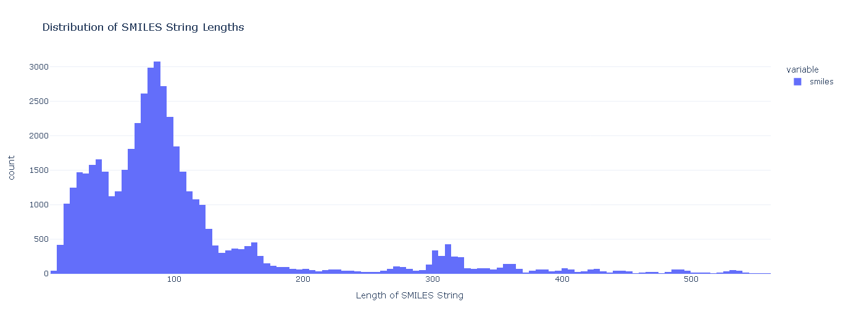
Lipid Data

Slide 5
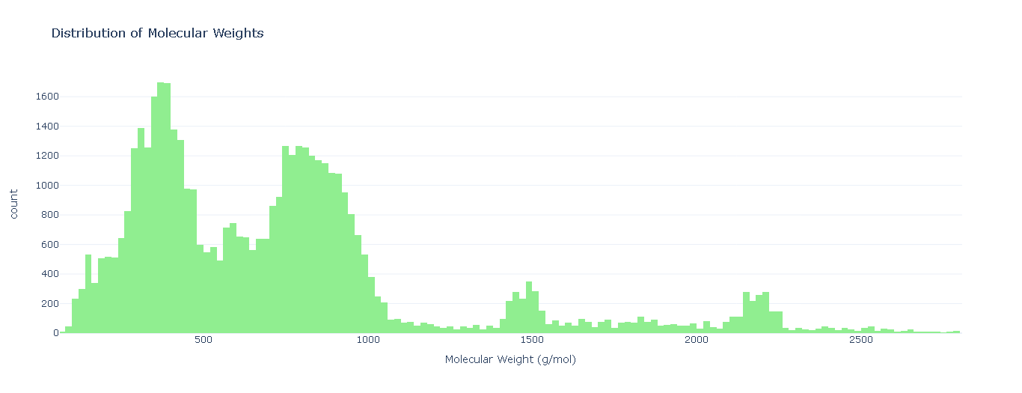
Lipid Data

Slide 6
Results
Validity Rate: Of the 100,000 generated lipids, 97.94% were valid SMILES, demonstrating high accuracy of the model.
Uniqueness Rate: Among these valid SMILES, 44.69% are unique, showing the model's capability to produce a variety of lipid structures.
Novelty Rate: 51.67% of the unique valid SMILES are new. 23.05% of the new SMILES are neither substrings nor superstrings of any SMILES in the training set. Highlighting the model's potential in discovering previously unknown lipids.

Slide 7
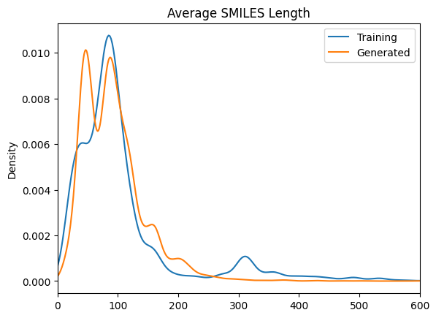
Comparisons

Slide 8
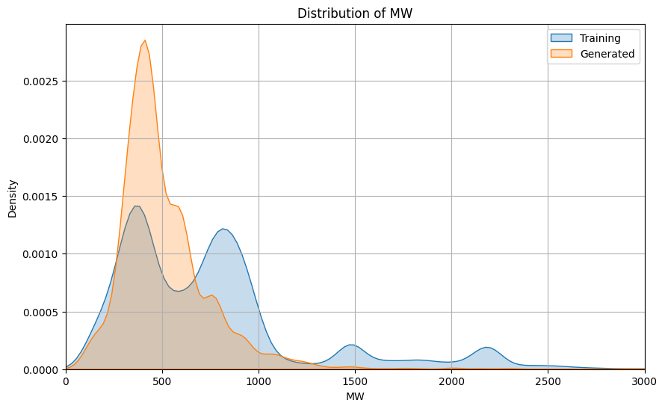
Comparisons

Slide 9
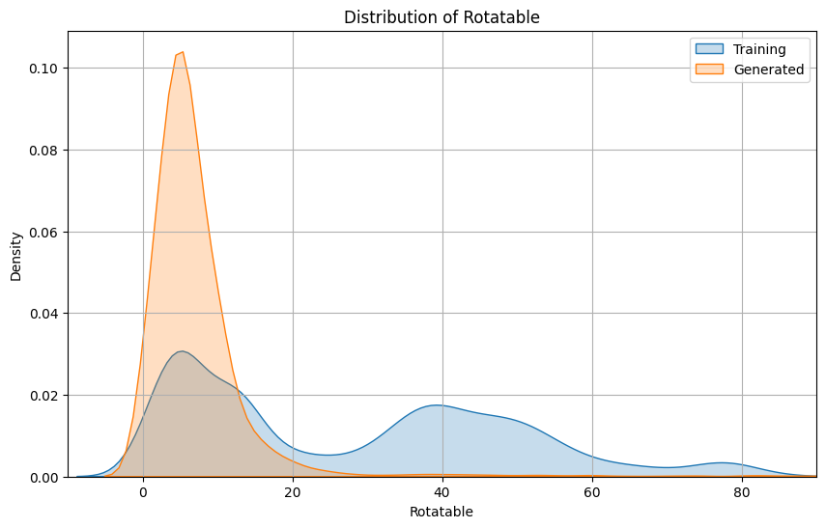
Comparisons

Slide 10
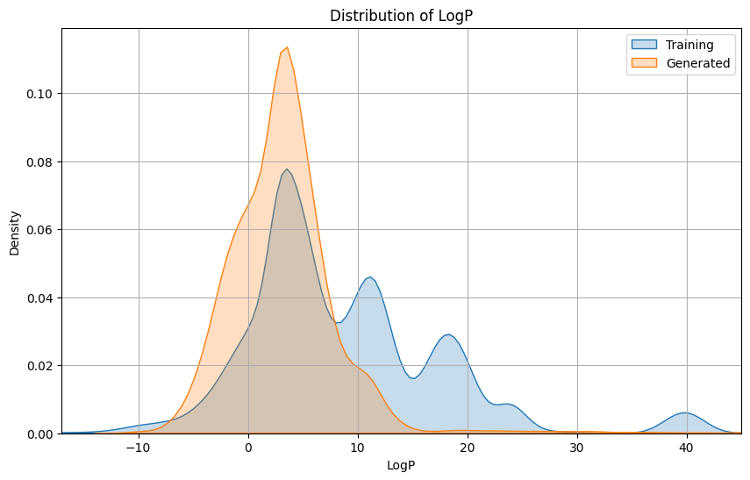
Comparisons

Slide 11
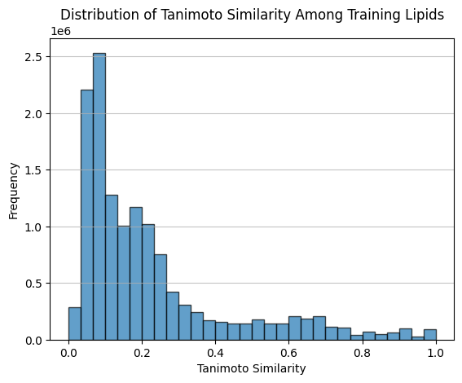
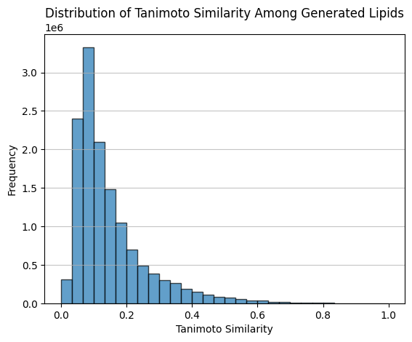
Comparisons

Slide 12
Conclusion
Valid New Molecules: Demonstrated strong capability in generating valid, new molecules, highlighting its promise in molecular design.
Diversity Challenge: The model tends to produce less diverse molecules compared to the training set, signaling a need for further refinement.
Chemical Property Shift: Noted a shift in chemical properties in generated molecules, opening possibilities for unique molecular discoveries.
Application: Offers potential as a brainstorming aid for molecule design, useful in accelerating drug development and biochemical research.
Future Focus: Improve diversity in generation and align chemical properties more closely with targeted outcomes.

